Slide 1

Group 3
Software Manager: Dirk Thieme
Hardware Manager: Erik Manis
Project Controller: Mohammed Ansari

Slide 2
Rover Mini Project
Summary: Use the BASYS 3 board’s built-in switches to control the speed and direction of the motors inside of a rover based on which switch is pulled.
Goals: Build a better understanding of the board, the h-bridge, and the Verilog software.

Slide 3
Hardware Update
PMOD

Slide 4
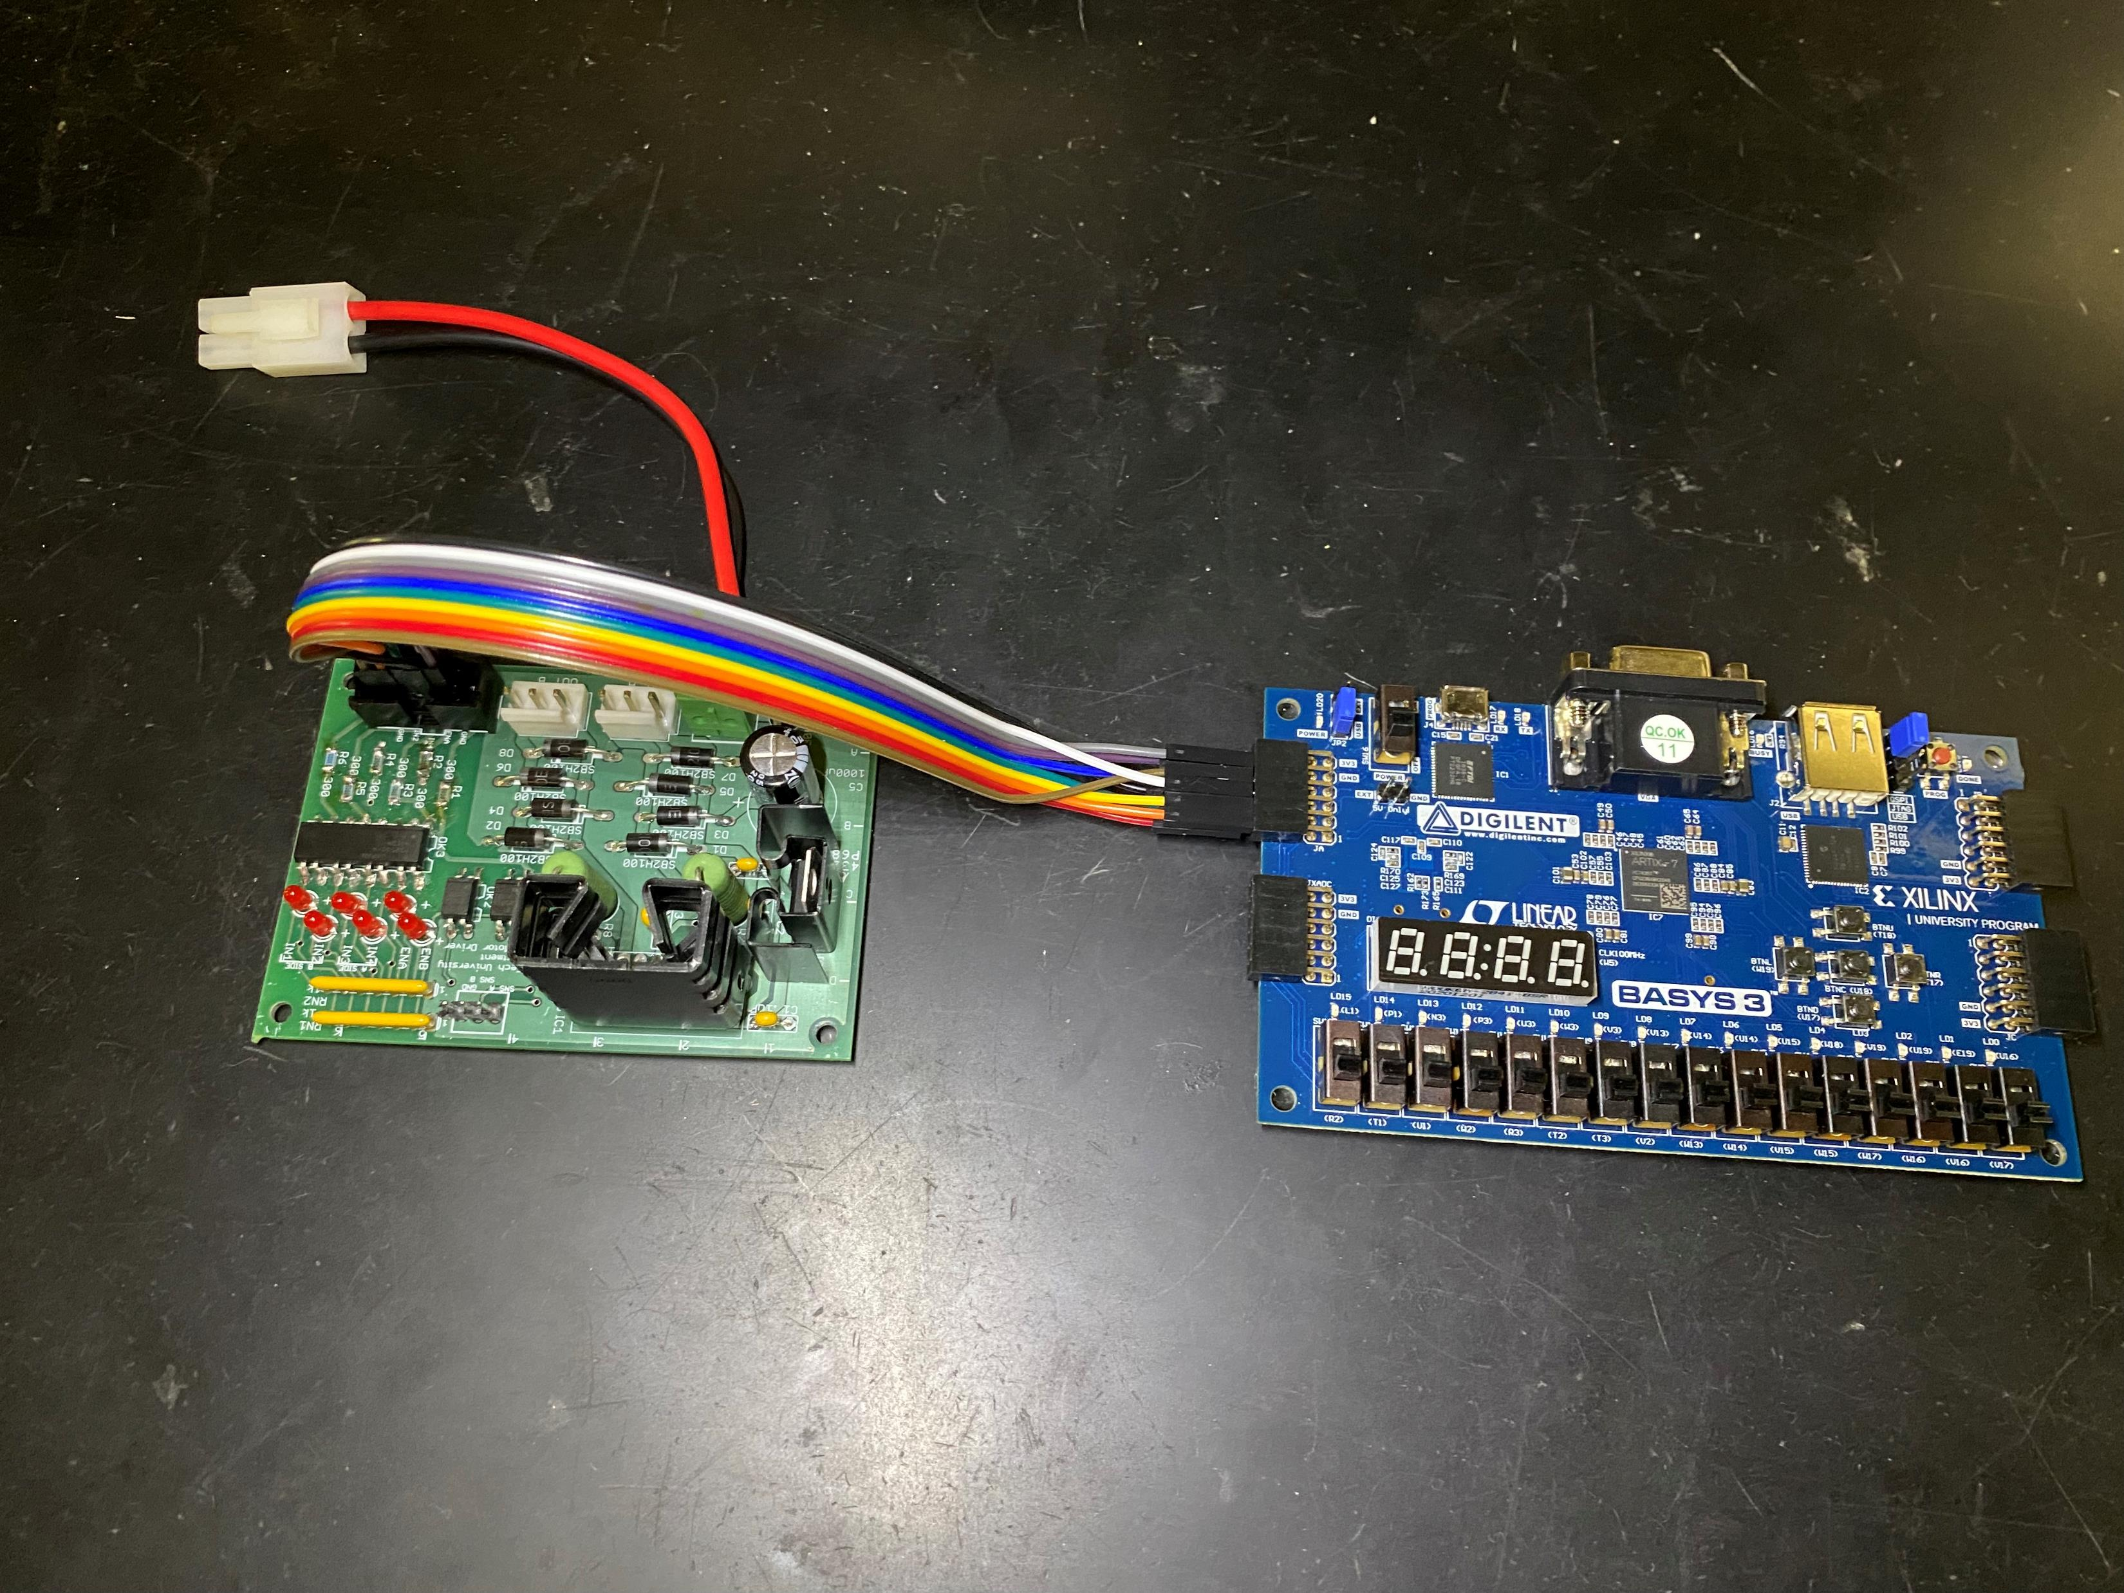
Hardware Update
PMOD

Slide 5
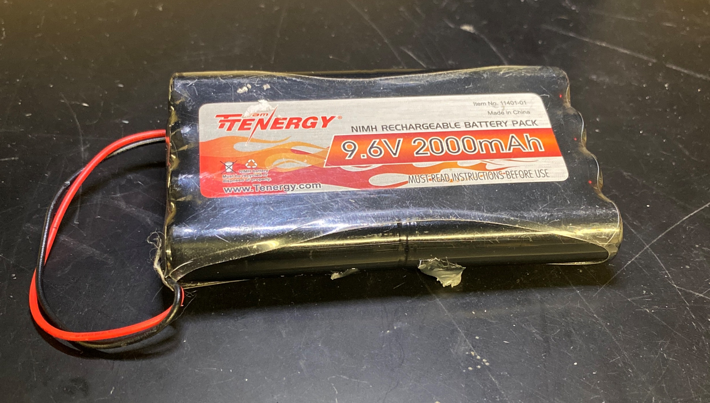
Hardware Update
The Battery
9.6V 2,000mAh
(Actually 11.6V)

Slide 6
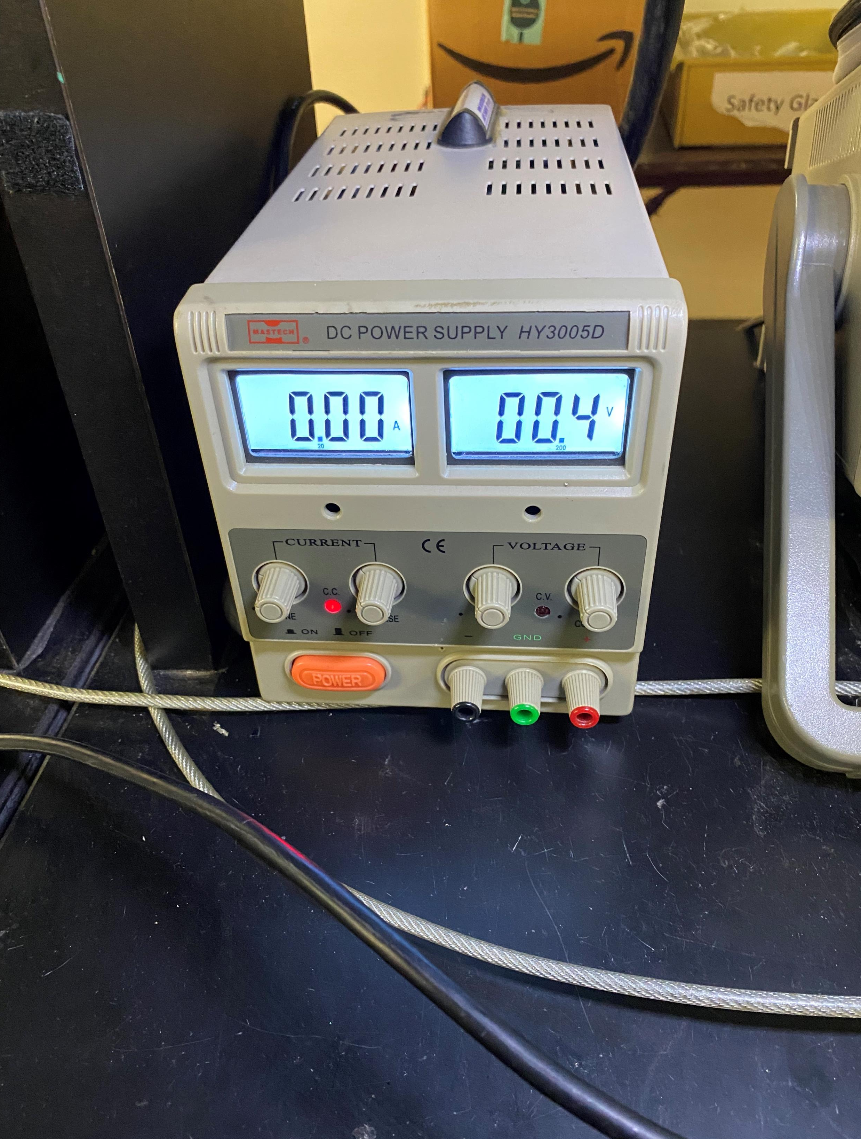
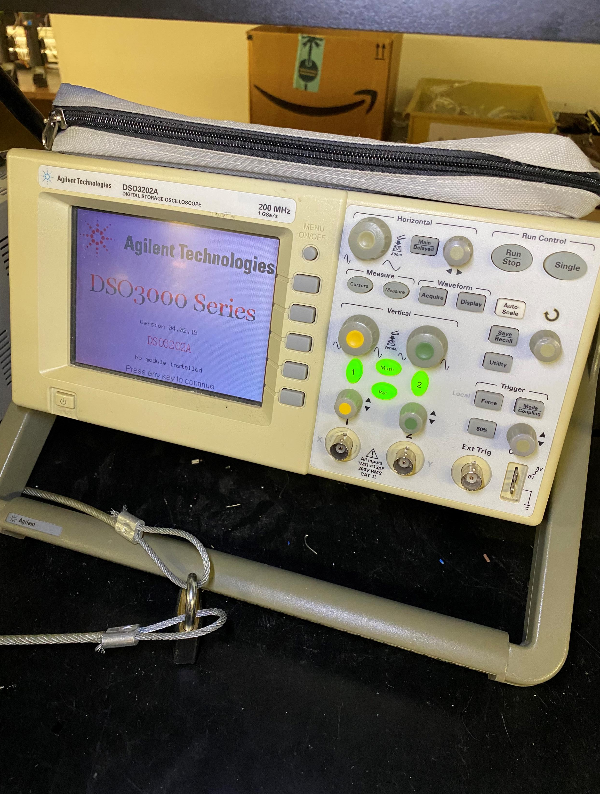
Hardware Update
All the lab equipment has been tested. I used the function generator to test the o-scope. I also used the power source to test the multimeter.

Slide 7
Hardware Update
I tested the rover to see if it was functioning at the very least. I hooked up the power supply to test the rotors. I used 5 volts and they pulled about 0.3 amps. I made sure to test both rotors, in both directions to make sure everything is running smoothly.

Slide 8
Hardware Update
We obtained all the parts necessary for the rover and we are going to start making an enclosure for the boards, so they are not bumped or damaged.

Slide 9
Hardware Update

Slide 10
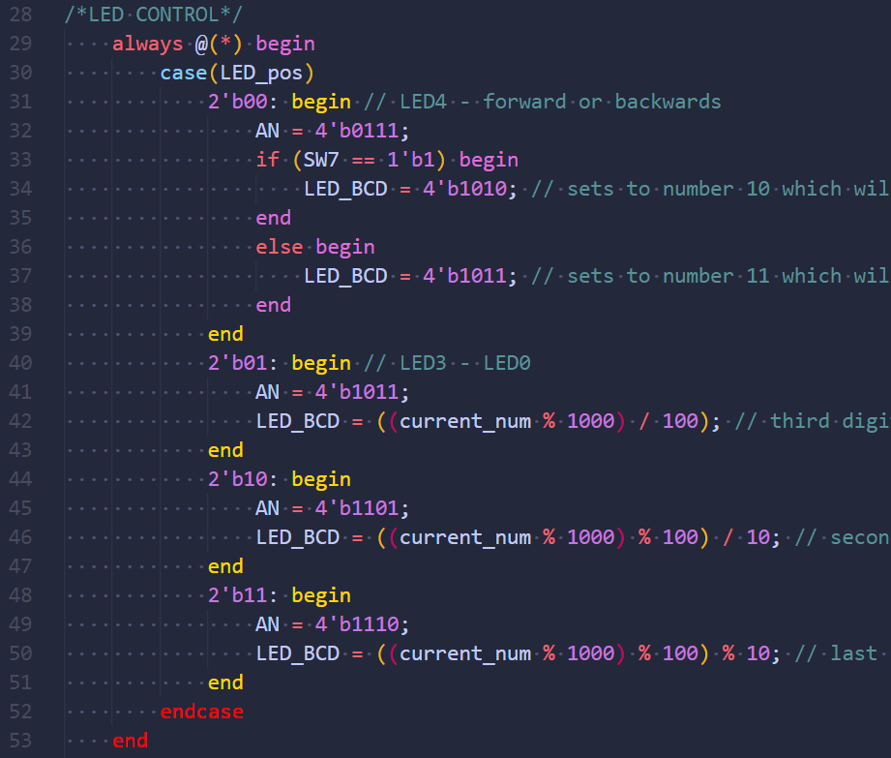
Software Update

Slide 11
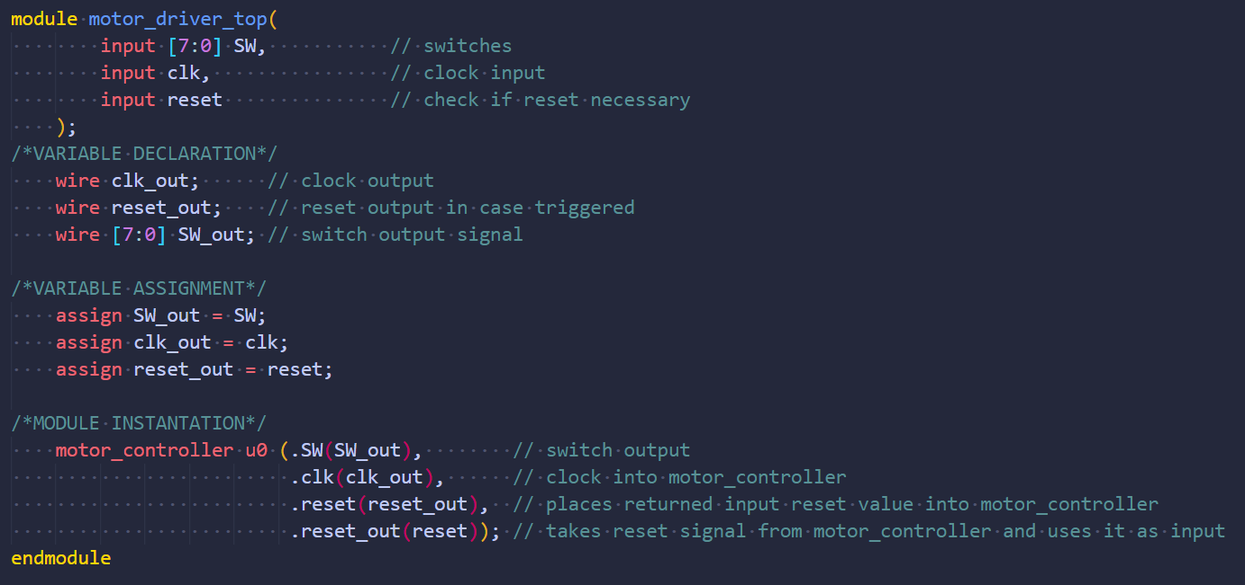
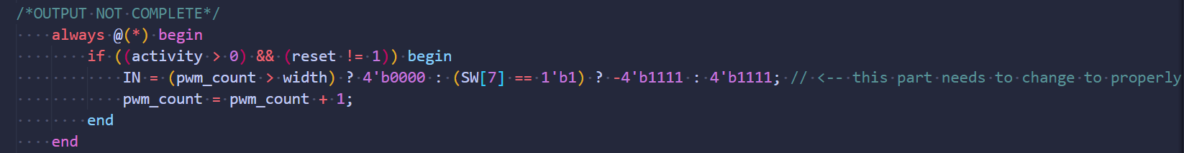
Software Update

Slide 12
Software Update

Slide 13
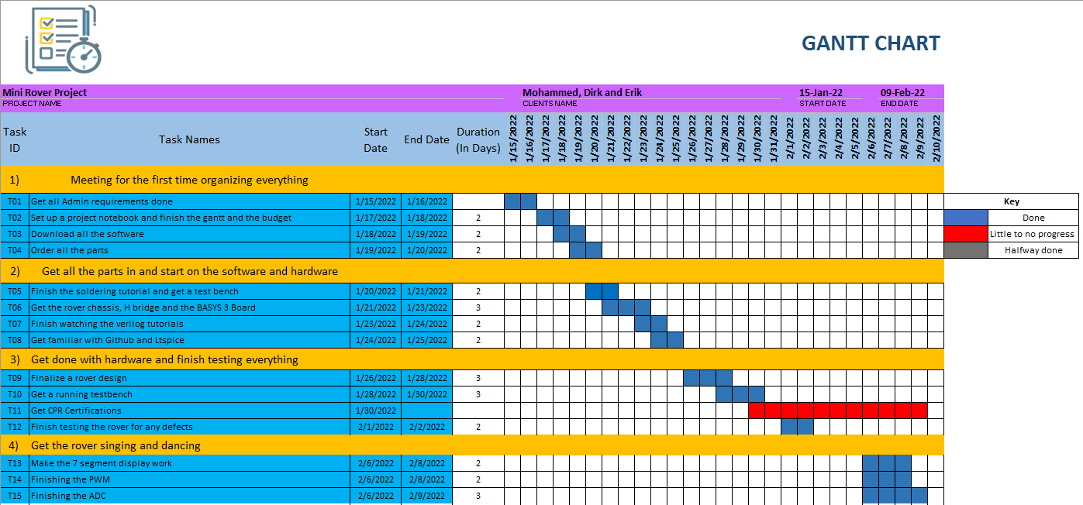
Gantt

Slide 14
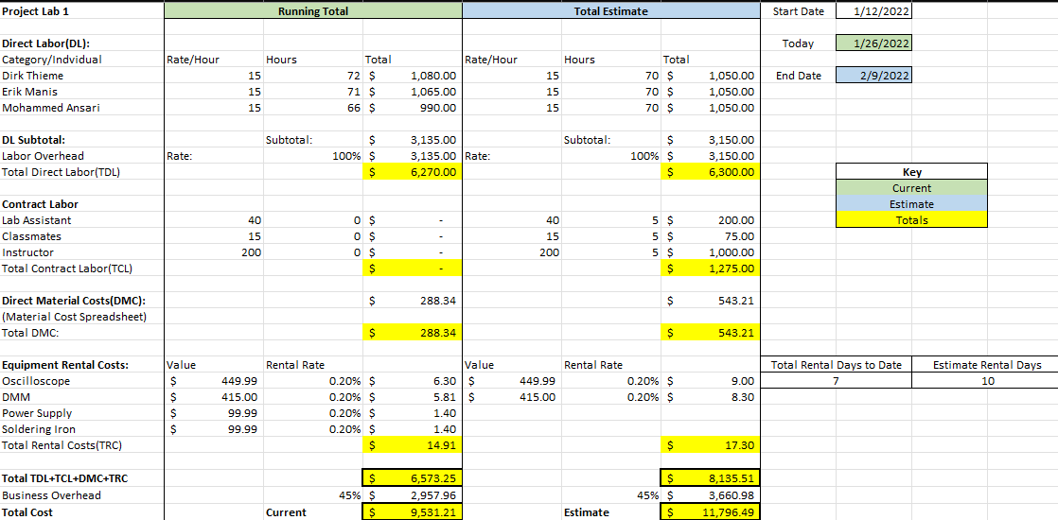
Overall Budget

Slide 15
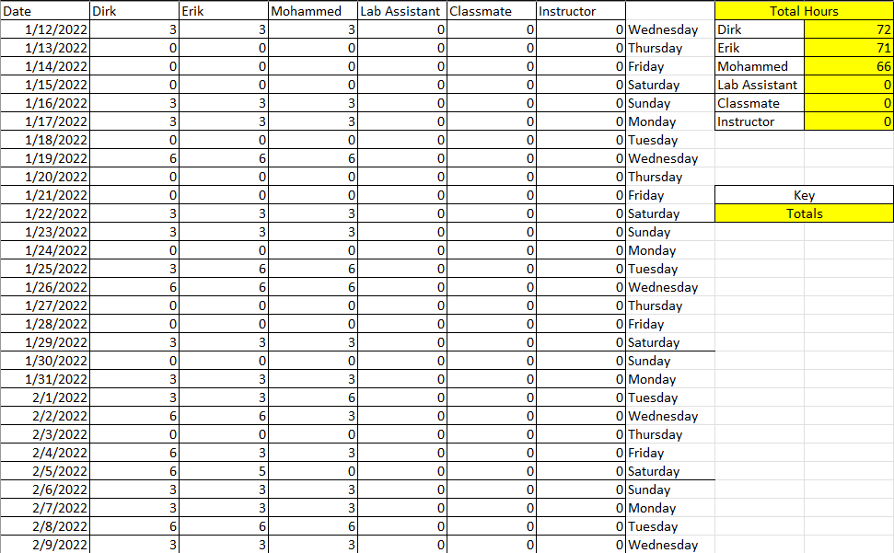
Labor Costs

Slide 16
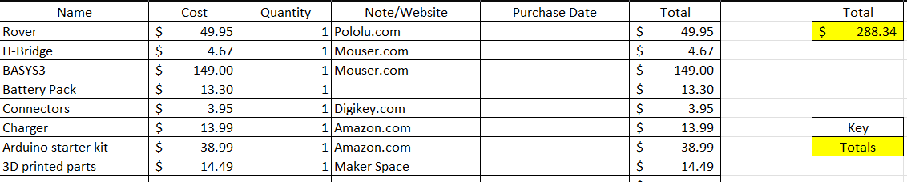
Material Costs

Slide 17

Questions
Software Manager: Dirk Thieme
Hardware Manager: Erik Manis
Project Controller: Mohammed Ansari
This Photo by Unknown author is licensed under CC BY.

